Slide 1

PROJECT TITLE :
EMPLOYEE ATTRITION PROBLEM
PREPARED BY :
VINAY KUMAR KYATHAM
kyathamvinayus@gmail.com

Slide 2
INTRODUCTON
Company Name : Hashanalytic (UK Company)
Domain : DATa analytics
Project Title : EMPLOYEE Attrition problem
Project Description : The problem statement is regarding the attrition of employees in a company X. We are provided with a two sets of data out of which one gives the details of the ex-employees and the other gives the details of the current employees. We can solve this problem by analysing the data using Numpy and pandas and visualizing using tableau. Thus, with the obtained useful information the current state of the working employees can be predicted easily.
Size of Training Data : 11,999 records
Size of test set : 3000 records
Period of Internship : 1 Month (From 18/06/2020 to 18/07/2020)

Slide 3
Problem Statement
The data is for company X which is trying to control attrition. There are two sets of data: "Existing employees" and "Employees who have left".
Following attributes are available for every employee.
Satisfaction Level
Last evaluation
Number of projects
Average monthly hours
Time spent at the company
work accident
promotion in the last 5 years
Departments (column sales)
Salary Whether the employee has left
OBJECTIVE
What type of employees are leaving? Determine which employees are prone to leave next.

Slide 4
Analysis of the Project data file:
Employee Details
Number of existing employees= 11,428
Number of employees that left= 3,571
% employees that left= 31.2 = 32% (approx.)

Slide 5

DATA VISUALISATION TOOL – TABLEAU INRODUCTION
* Tableau is a visual analytics platform transforming the way we use data to solve problems empowering people and organizations to make the most of their data.
* Tableau is a powerful and fastest growing data visualization tool used in the Business Intelligence Industry. It helps in simplifying raw data in a very easily understandable format. Tableau helps create the data that can be understood by professionals at any level in an organization. It also allows non-technical users to create customized dashboards.
Data analysis is very fast with Tableau tool and the visualizations created are in the form of dashboards and worksheets.
*The best features of Tableau software are
Data Blending
Real time analysis
Collaboration of data

Slide 6
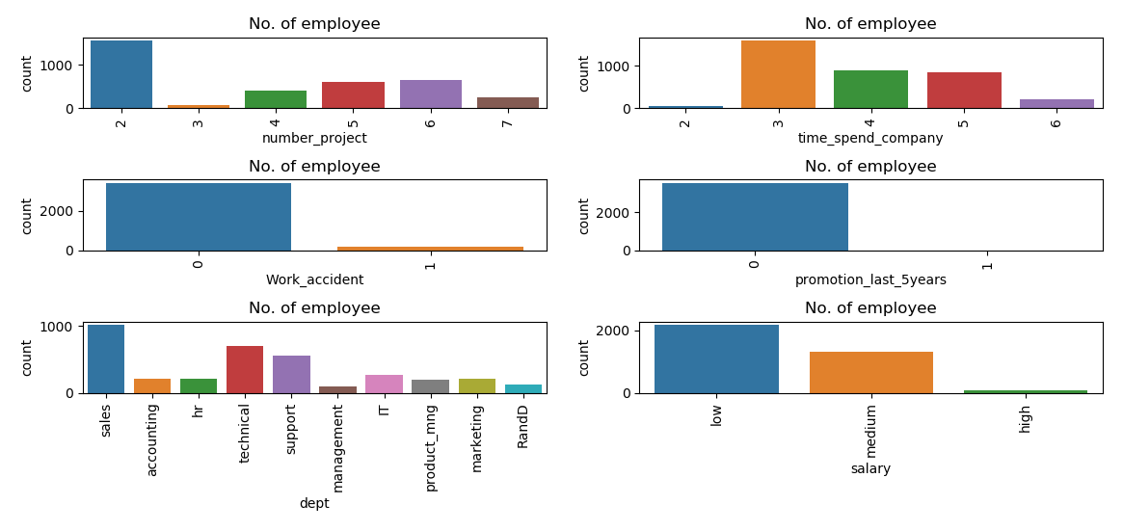
Bar plot showing the type of employees leaving the job

Slide 7
Major factors contributing to employee attrition as observed from the graphs are:
No promotion in the last 5 years-
Employees tend to quit if there is no promotional aspect to their job to keep them motivated.
Time spent at the company-
There is a higher chance of an employee resigning his job after completing 3 years of work.
Salary-
The lower the income higher are the chances of leaving the job.
Accidents at workplace-
This raises question on the safety of the employee at workplace which is also a determining factor for employee turnover.

Slide 8
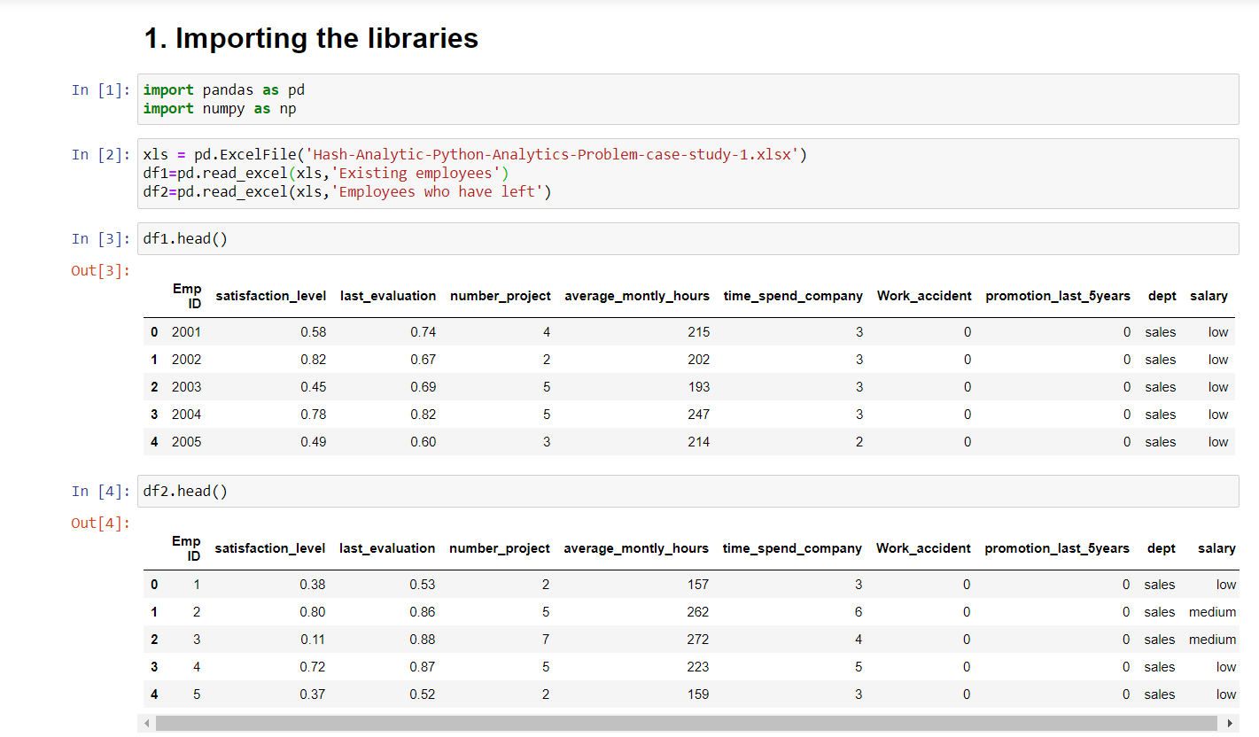
Output Screenshots

Slide 9
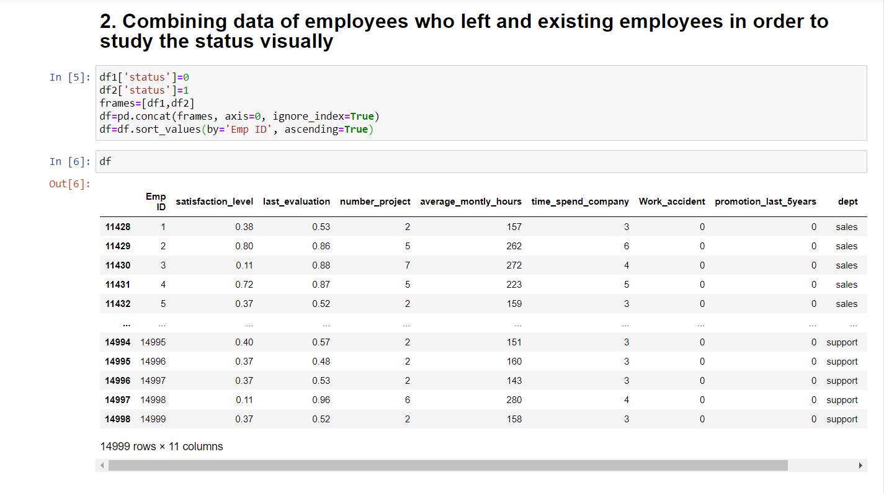
Output Screenshots

Slide 10
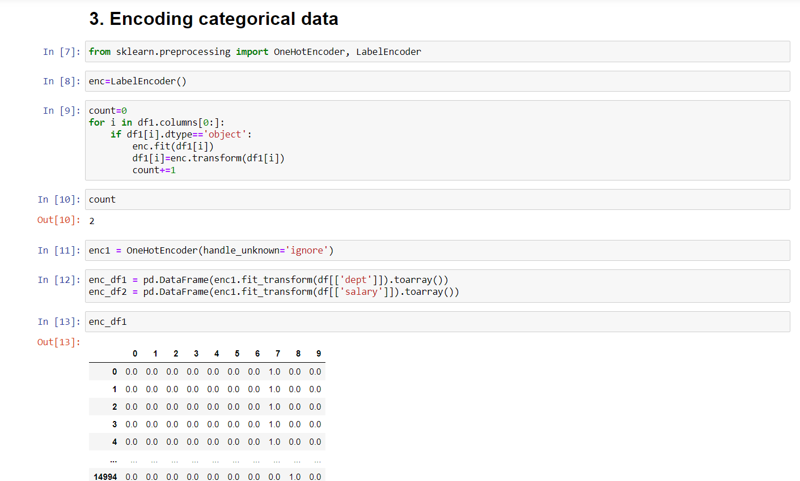
Output Screenshots

Slide 11
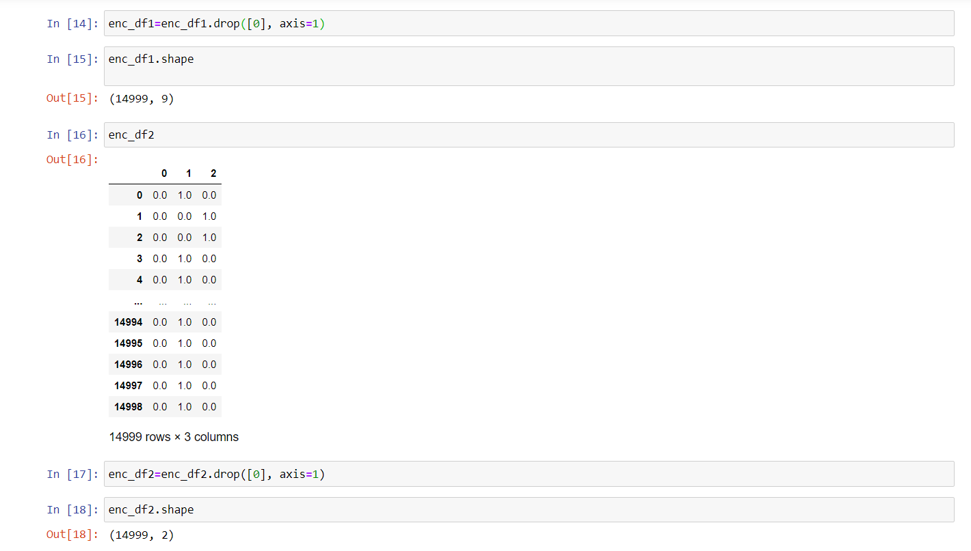
Output Screenshots

Slide 12
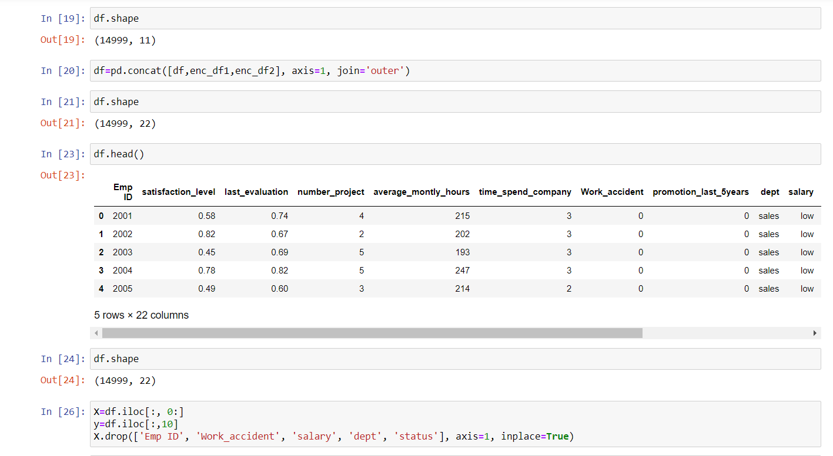
Output Screenshots

Slide 13
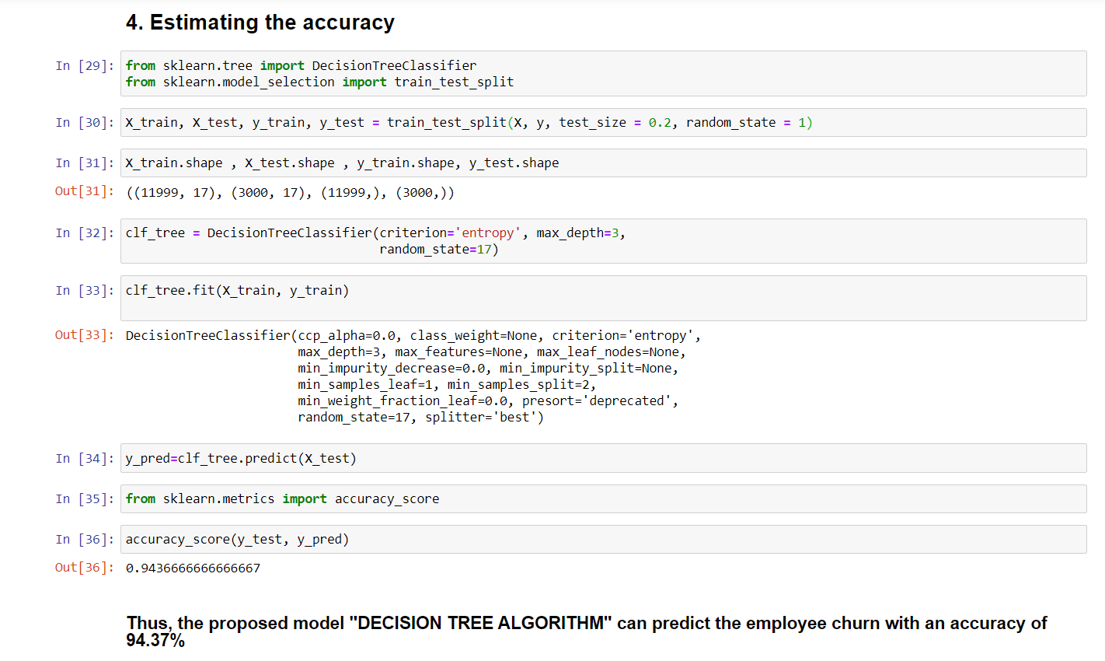
Output Screenshots

Slide 14
Analysis of first 10 entries from the
“EMPLOYEES WHO HAVE LEFT” dataset
Emp ID | satisfaction_level | last_evaluation | number_project | average_montly_hours | time_spend_company | Work_accident | promotion_last_5years | dept | salary
1 | 0.38 | 0.53 | 2 | 157 | 3 | 0 | 0 | sales | low
2 | 0.8 | 0.86 | 5 | 262 | 6 | 0 | 0 | sales | medium
3 | 0.11 | 0.88 | 7 | 272 | 4 | 0 | 0 | sales | medium
4 | 0.72 | 0.87 | 5 | 223 | 5 | 0 | 0 | sales | low
5 | 0.37 | 0.52 | 2 | 159 | 3 | 0 | 0 | sales | low
6 | 0.41 | 0.5 | 2 | 153 | 3 | 0 | 0 | sales | low
7 | 0.1 | 0.77 | 6 | 247 | 4 | 0 | 0 | sales | low
8 | 0.92 | 0.85 | 5 | 259 | 5 | 0 | 0 | sales | low
9 | 0.89 | 1 | 5 | 224 | 5 | 0 | 0 | sales | low
10 | 0.42 | 0.53 | 2 | 142 | 3 | 0 | 0 | sales | low
Satisfaction level cannot be a deterministic factor for employee turnover as we see widely varying ranges.
People with high level of satisfaction also tend to quit.
But if we compare the time spent at company with satisfaction level it can be inferred that :
The employee might resign at the completion of 3 years given satisfaction_level<0.5
Cases where satisfaction level is high there tends to be an issue of work pressure.
That is, Higher average of working hours.

Slide 15
Analysis of last 10 entries from the
“EXISTING EMPLOYEES” dataset
Emp ID | satisfaction_level | last_evaluation | number_project | average_montly_hours | time_spend_company | Work_accident | promotion_last_5years | dept | salary
14202 | 0.49 | 0.49 | 4 | 212 | 7 | 0 | 0 | product_mng | medium
14203 | 0.6 | 0.53 | 2 | 235 | 7 | 0 | 0 | IT | medium
14204 | 0.62 | 0.85 | 3 | 237 | 3 | 1 | 0 | IT | medium
14205 | 0.64 | 0.5 | 4 | 253 | 10 | 0 | 1 | management | high
14206 | 0.22 | 0.94 | 3 | 193 | 10 | 0 | 1 | management | high
14207 | 0.9 | 0.55 | 3 | 259 | 10 | 1 | 1 | management | high
14208 | 0.74 | 0.95 | 5 | 266 | 10 | 0 | 1 | management | high
14209 | 0.85 | 0.54 | 3 | 185 | 10 | 0 | 1 | management | high
14210 | 0.33 | 0.65 | 3 | 172 | 10 | 0 | 1 | marketing | high
14211 | 0.5 | 0.73 | 4 | 180 | 3 | 0 | 0 | IT | low
Major reasons why employees stay in the company for longer terms is:
Promotion in the past years.
Better salary packages (medium to high salary)

Slide 16
I analysed a small random portion of the data and have made predictions theoretically.
For programming in python we will use looping statements. Thus, it will enable us to
analyse the complete dataset.
This will improve the efficiency of the output.
Then we can effectively track which employee is about to leave and take the necessary steps
I propose to solve the given problem statement using :
“DECISION TREE ALGORITHM”

Slide 17
What is Decision tree algorithm?
It is an algorithm which uses a decision tree (as a predictive model) to go from observations about an item (represented in the branches) to conclusions about the item's target value (represented in the leaves). It is one of the predictive modeling approaches used in statistics, data mining and machine learning.
According to Decision tree let us consider:
“Employees that have left” as the training set AND
“Existing employees” dataset as the testing set
This methodology can be used to determine what type of employees are highly likely to leave the company.

Slide 18
EMPLOYEES PRONE TO LEAVE NEXT
Work experience
<= 3 years
> 3 years
High number of average monthly hours
(>200 hrs )
Low satisfaction
(<0.5)
Still no promotion
Low salary
+
extensive working hours

Slide 19

Companies should maintain healthy
work environment
Every company implements different ways
to boost its business growth.
Similarly, it is equally important to meet
the expectation of employees in return for
their hard work and dedication.
Appreciate them for their work.

Slide 20




WAY TO SOLUTIONS…
Better employment and
promotional opportunities
Keeping a check on salary
with regular increments
Reducing the work pressure
Safety at workplace

Slide 21
SYSTEM REQUIREMENTS SPECIFICATIONS
System configuration
• System: Intel i3 4th Gen processor.
• Hard Disk: 500 GB.
• RAM: 2GB
• High Speed Internet
2. Software Requirements
Operating System: Windows 7 or any other OS.
Coding Language: Python.
IDE: Jupyter Notebook, Atom, Anaconda, PyCharm, Google Collab etc.
3. Hardware Requirements
None.

Slide 22
bibiliography
References:
Google images
Python3 documentation (https://docs.python.org/3/whatsnew/3.9.html#summary-release-highlights)
Data set from HashAnalytic company
https://en.wikipedia.org/wiki/Decision_tree_learning
https://www.tableau.com
https://colab.research.google.com/drive/1NoMpLYF-XX2pdlA-8ynddvOmrs13SYQj#scrollTo=Zst2W4gM7EcIcom
https://hashanalytic.com/internship/

Slide 23
Thank you

